Slide 1
TOURISMO
INTRODUCTION:
Tourism is exploring the secrets of the world alone or with friends, learning about culture, history and traditions of different regions. It’s the act of travelling within your own country or to an international destination, for either the purposes of business or pleasure. Exploring everything all around the world is a new trend these days.
So, “Tourismo” is an application used as a tourism guide assisting tourists with features like:
Map assistance
Travel recommendation
Travel perquisites
Spot Description
Navigation
Voice assistance
Emergency support

Slide 2
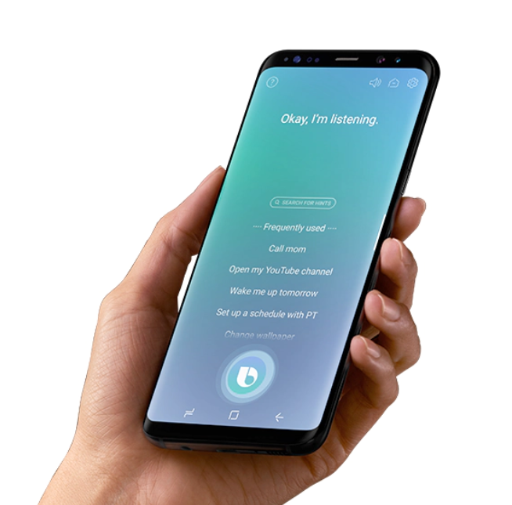
APPLICATION TECHNICALITIES
The steps required to use the application are:
App Installation
User registration
GPS enabling
Spot selection
App functionalities:
Tourist spot recommendations
Spot description
Reviews
Navigation & site description of the spot
Prerequisites & SoS

Slide 3
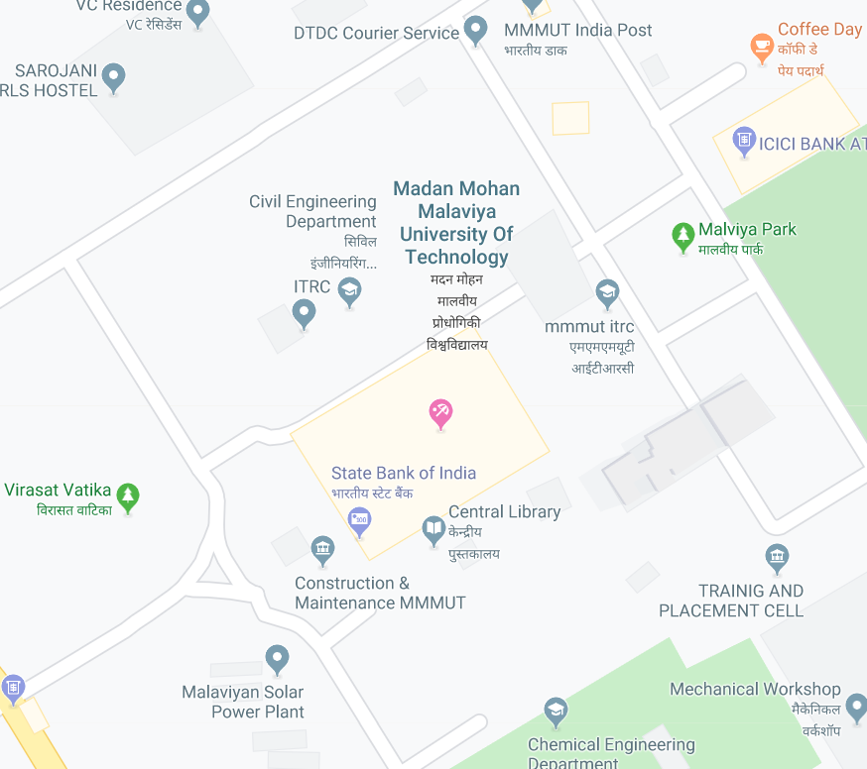
MAP ASSISTANCE
If a person reaches the site which he/she wants to explore. This App offers the feature of map assistance with which the entire two dimensional plan of the region can be viewed by the tourist.
The Map helps the user to take a detailed overview of the region he/she is interested in visiting. The map will show the paths and other infrastructural components available to the visitor with the help of the GPS.
Depending upon the map, the tourist can decide the systematic tour of various places present in the region without incurring heavy conveyance and other costs.
This app will take the Madan Mohan Malaviya University of Technology in to consideration.

Slide 4
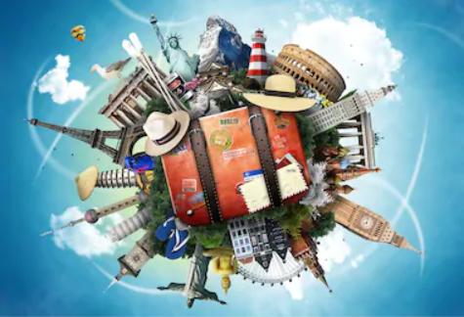
TRAVEL RECOMMENDATION
Once the user open the application to have an overview of the region he wants to explore, the app displays him/her the different tourists spot as recommendation depending upon the reviews of the other travellers who had already visited that place.
Depending upon the ratings and reviews, the user will select a specific site from the list of priorities for further description and other information such as navigation, etc.

Slide 5
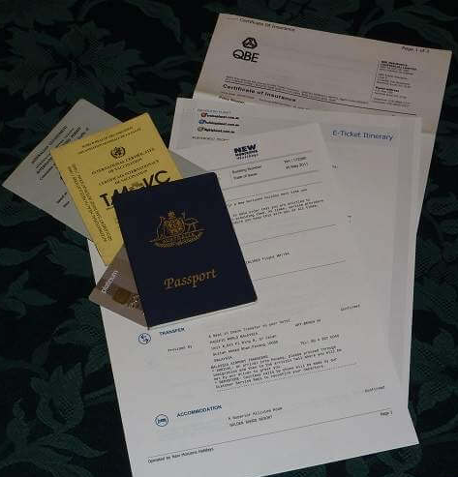
TRAVEL PREREQUISITES
After selecting the place you want to visit, you will be redirected to the travel prerequisite for the concerned site.
The prerequisites include id-proof like visa, passport, aadhar, voter ID, PAN card, etc; travel passes, tokens, toll passes, luggage permissions, etc.
Depending upon the availability of the tourism, you can make up your mind as to whether you will visit that place or not.

Slide 6
SPOT DESCRIPTION
Once the tourist selects the site as per his choice from the list of travel recommendations, the next feature given by this application is the description of that particular site.
The description, in the language chosen by the user, includes the history of the site, geographical details, amazing facts, importance of the site, etc.
This section will be enhanced by pictorial presentation too.

Slide 7
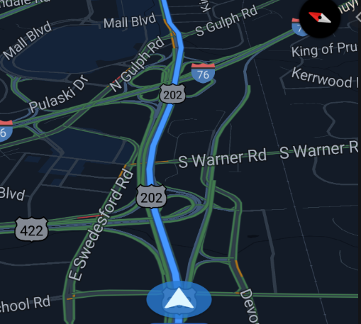
NAVIGATION
This app will navigate the visitor and suggest the different paths which leads to the desired location.
The position from where the user takes the help of this application, he gets to know the distance remaining from the destination or intermediate locations and also the real time location of the user.
This helps the tourist to find the shortest possible way out to the destination available which helps us to save the cost incurred.

Slide 8
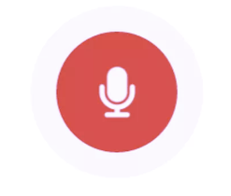
VOICE ASSISTANCE
The app also provides its users the feature of voice assistance (Alexa).
The input commands needed for desired output can be given not only via typing or tapping but also through voice notes.
This helps the tourist of a significant problem they face- “Language Barrier” and makes their trip easy and comfortable. The cost of the trip is also saved indirectly.
The app will have an auto read option in various languages as well.

Slide 9
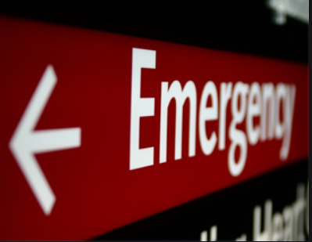
EMERGENCY SUPPORT
This section provides the details of the emergency support required at a time of panic or urgent needs.
The emergency support provides the contact details of the on ground guides, police station, medical emergency support, fire station, etc.
In addition to this the contact details of the customer care will also be provided.

Slide 10
Thank you
EXPEDITION
Team Leader: XYZ
Team Members:
Member 1
Member 2
Member 3
Member 4
Member 5

